Slide 1


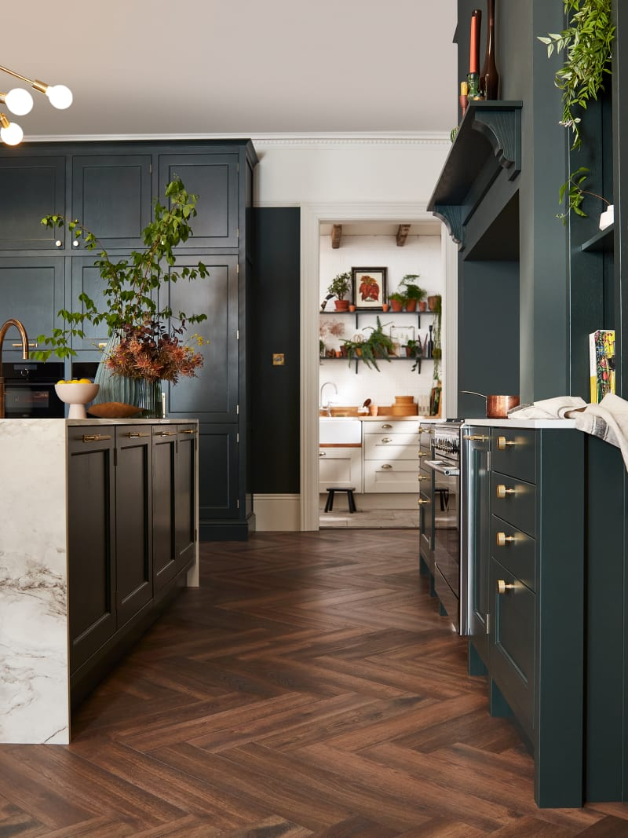
















HOW HOME AND GARDEN BRANDS ARE GROWING THEIR REVENUES WITH ESBCONNECT
WHO ARE WE?
With 8 years of experience, we are one of the UK's largest owners of consumer & B2B email data and a proprietary customer acquisition platform. We leverage a GDPR compliant and fully-opted in database of consumers & 130+ data points on each email to deliver 50m+ emails/month on behalf of a wide range of clients, help them increase their CRM databases & deliver unique email-enriched audiences to their paid media platforms.
THE BRANDS
THE CHALLENGES
The average person undertakes home improvement projects every 5-10 years. Hitting the right audience at the right time is critical.
Consumers are only likely to purchase large household items or undertake renovations a few times in their lifetime. Most people may only buy a new kitchen twice and may only replace their mattress every 8 years. Hitting a person at the right time is difficult.
Homemovers are primed to spend but hard to identify. On average, over £25k is spent on home improvements and furnishing within 6 weeks of moving home.
People who have been in their home for more than 5-8 years are more likely to spend on home improvement projects but identifying these individuals is difficult.
Renters are more likely to spend on soft furnishing
As purchases are infrequent, brand recall is critical, so you are front of mind when the time comes.
Brands must create ‘marketing pulls’ to increase purchase frequency.
Audience targeting, media planning & activation
Leveraging esbconnect’s data-driven email marketing product, we were able to precision target key audiences including:
Audience Deep Dive
For brands like Anglian, we targeted people who did not have double glazing or whose homes had a low EPC rating.
For Tapi, we looked at consumers in specific locations who had recently moved or had been in their homes for over five years.
For Brook + Wilde, we looked at consumers who shopped at premium brands, had just moved or were renting.
For Designer Sofas and Magnet, we looked at people who had just moved, had been granted planning permission and/or were looking at home improvement finance.
THE AUDIENCES
WEALTH SCORE
EPC RATING
JUST MOVED
LIFE EVENTS
PURCHASE YEAR
PURCHASE INTENT
RENTER
PLANNING PERMISSION
GARDEN
INTERESTED? GET IN TOUCH FOR A CONSULTATION- HELLO@ESBCONNECT.COM

Slide 2






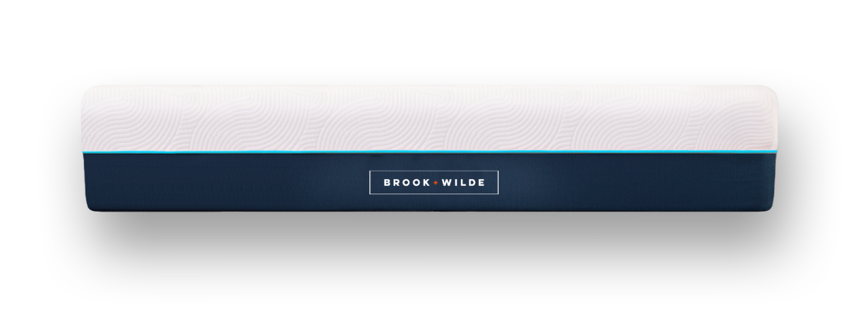

EXAMPLE USER JOURNEY
ad
Audience creation
Data Driven Email
Optional: Inbox Extend
Audience pushed to social or engagers retargeted.
Series of trigger emails to drive brand awareness and nurture consumer
Purchase
THE SERVICE
THE RESULTS
Creative Strategy: Developed content to drive a need, e.g. Brook + Wilde, associated a new mattress, with better sleep and recovery. Targeted c-suites, fitness enthusiast and parents.
Offer testing: Split test different promotions to understand uplift. For Designer Sofas this included ‘£250 voucher’ and ‘free gift’ with purchase.
Cross Channel: We combined social and TV to drive brand awareness, with email to ensure conversions. Tapi saw an increased uplift with email only but this was increased further with TV.
Retargeting: Adding retargeting via email or social towards pay day, increased sales by 38%.
Drove an average uplift of 14% in revenue across stores and online for carpet retailer
Contributed towards £3m of sofa sales in one year
Drove over 6000 leads for new kitchens in 12 months
Delivered an average CTR of 3% for the vertical
Identified over 3m active consumers
INTERESTED? GET IN TOUCH FOR A CONSULTATION- HELLO@ESBCONNECT.COM

